Slide 1
Data Warehouse for Car Features and Price Analysis
MET CS 779 ADVANCED DATABASE TERM PROJECT PRESENTATION
Professor
Dr. Jack Polnar
By
Sahithi Arekatla
U16464865

Slide 2
Overview
Datasets
ETL
Staging tables
Normalized Design
Load to normalized design
Dimensional star schema
SCD
Data Visualization

Slide 3
Datasets
There are 3 datasets used in this project. All of them are taken from kaggle website.
The 3 datasets are:
Car Features Dataset: This dataset has features like manufacturer, model, engine_volume, prodyear, mileage etc.
New Car Prices Dataset: This dataset consists of information like manufacturer, model, price variation, gear box type etc.
Old Car Prices Dataset: This dataset consists of manufacturer, model, date, minimum_price, average price.

Slide 4
ETL - Extract Transform Load
Extract: The datasets are extracted from the kaggle website.
Transform: Transformation of the data is done in python.
Dropped unnecessary columns
Removed null values
Renamed columns
Replacement of strings
Removed white strings
Splitting the column into multiple columns
Change datatypes of columns
Load : The data is load from csv files to postgresql using COPY command
COPY [ BINARY ] table [ WITH OIDS ]
FROM { 'filename' | stdin }
[ [USING] DELIMITERS 'delimiter' ]
[ WITH NULL AS 'null string' ]

Slide 5
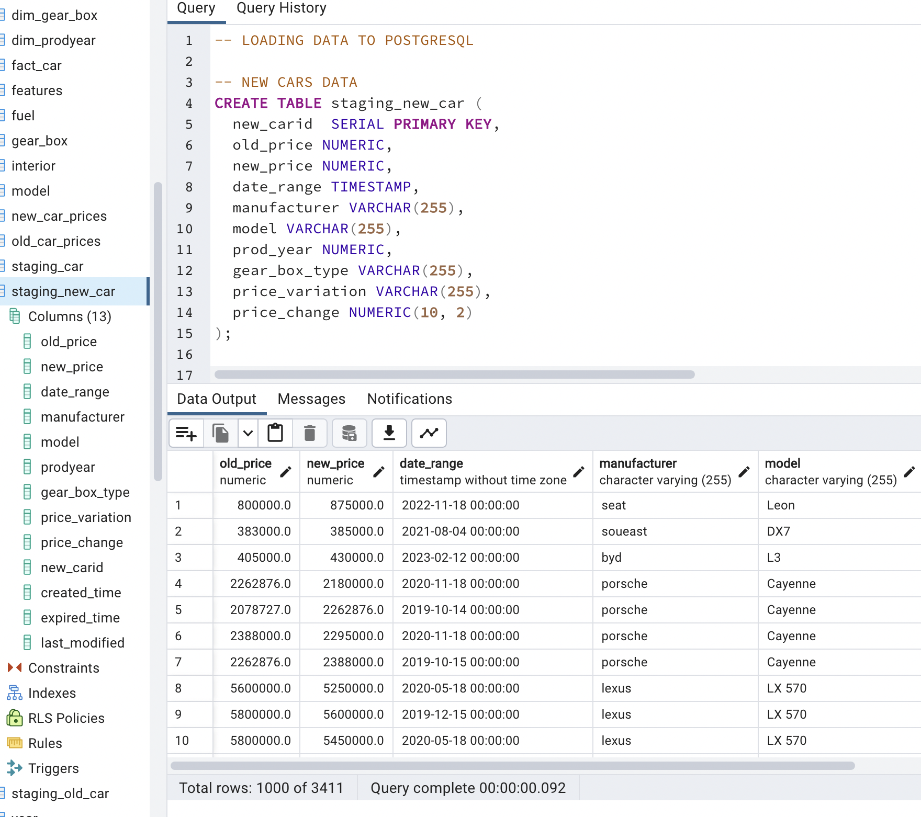
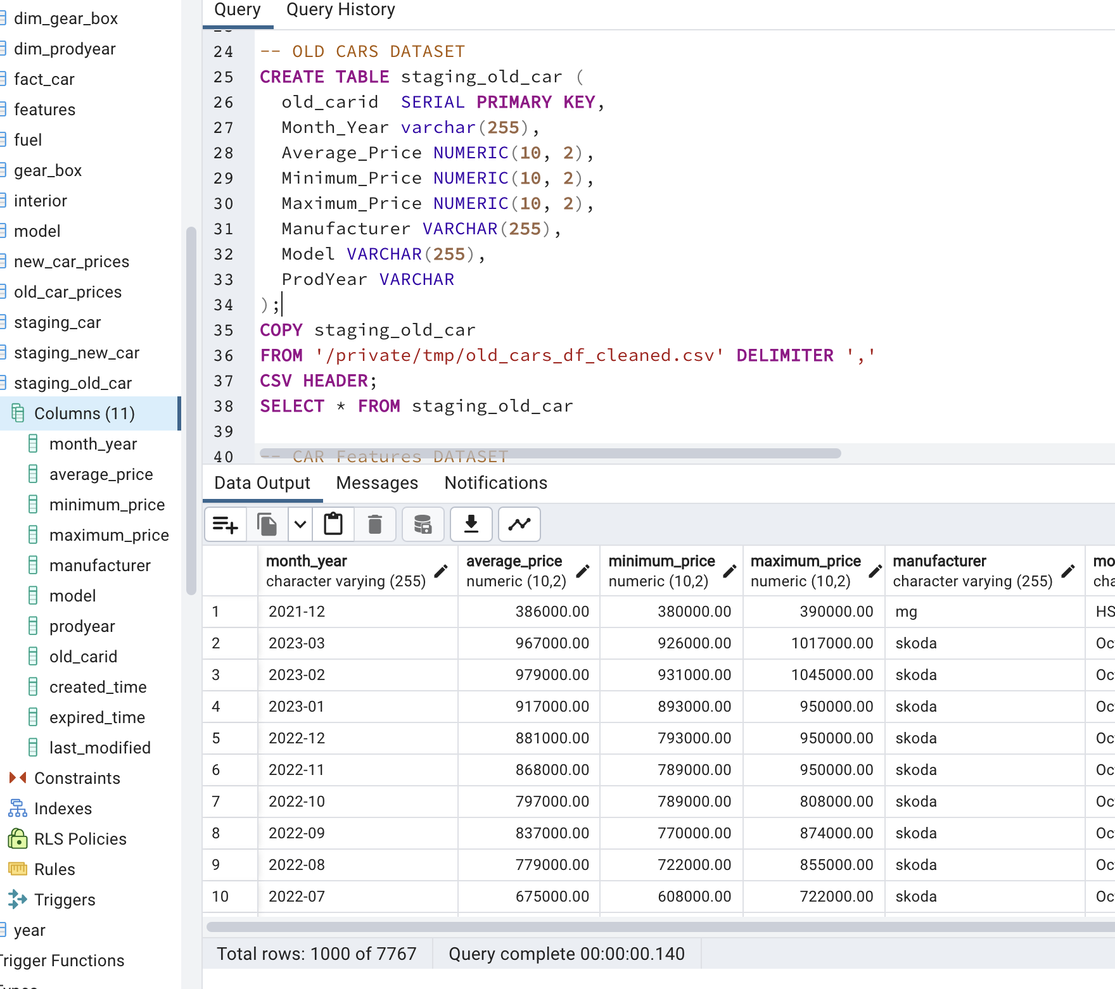
Staging tables

Slide 6
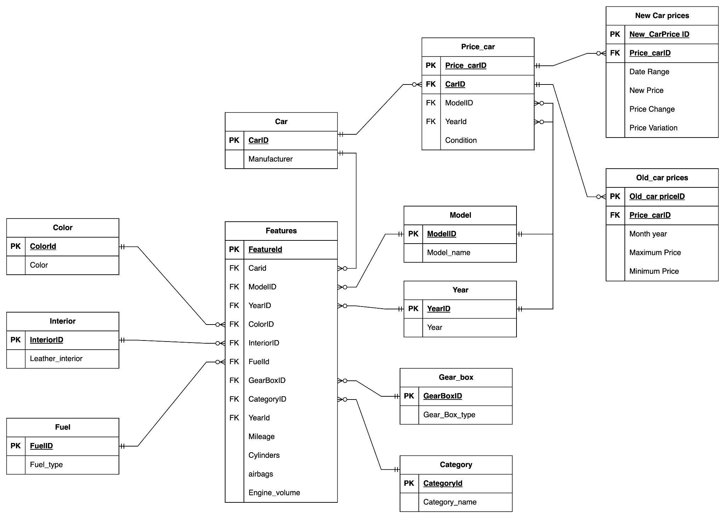
Normalized Design

Slide 7
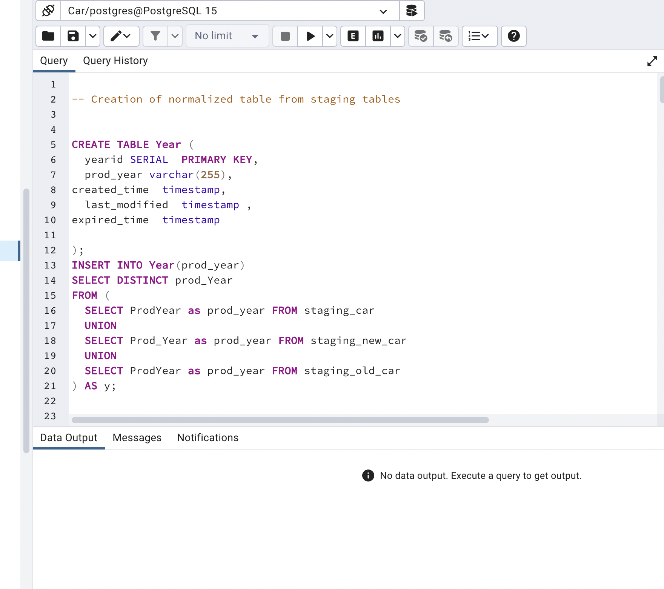
Loading to Normalized Design

Slide 8
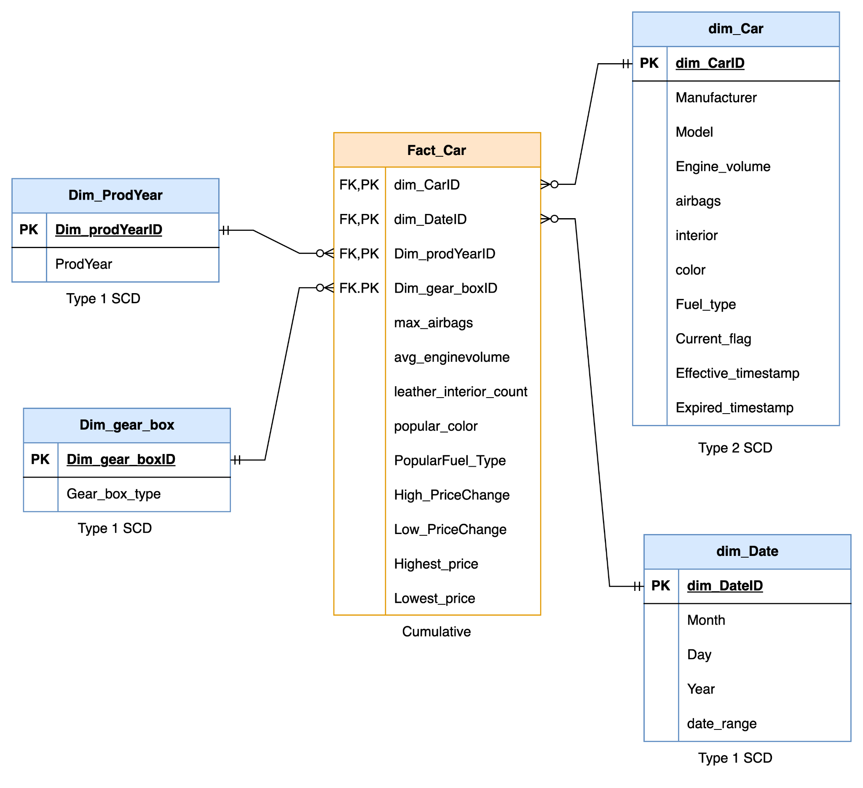
Dimensional Modeling
STAR
SCHEMA

Slide 9
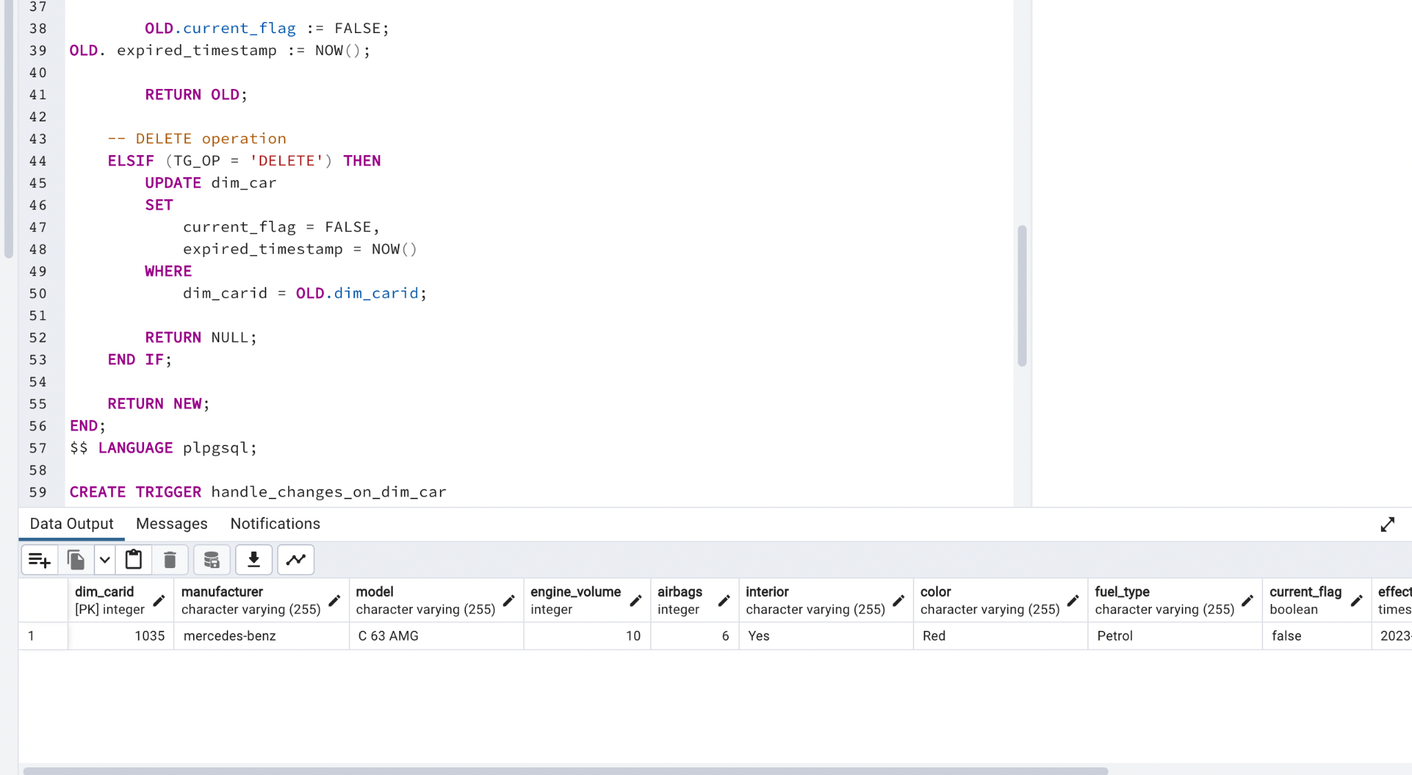
SCD Implementation
Triggers were used.
INSERT, UPDATE, DELETE

Slide 10
Business Questions
What is the average engine volume of the vehicles in the dataset?
How many vehicles in the dataset have leather interiors?
Which car model has more security? - airbags, manufacturer, model
the highest and lowest price changes, and how do these compare to each other?
Which car brand has the highest resale value?
What is the distribution of car prices across different car brands and production years?
Which car brand has the highest average price?

Slide 11
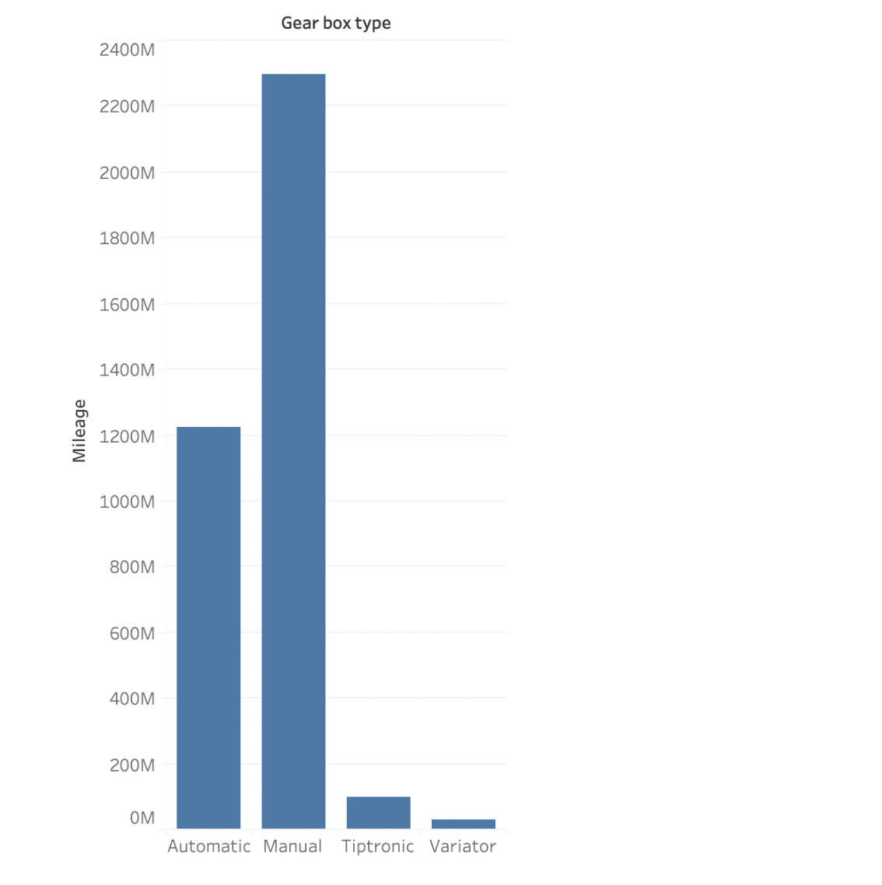
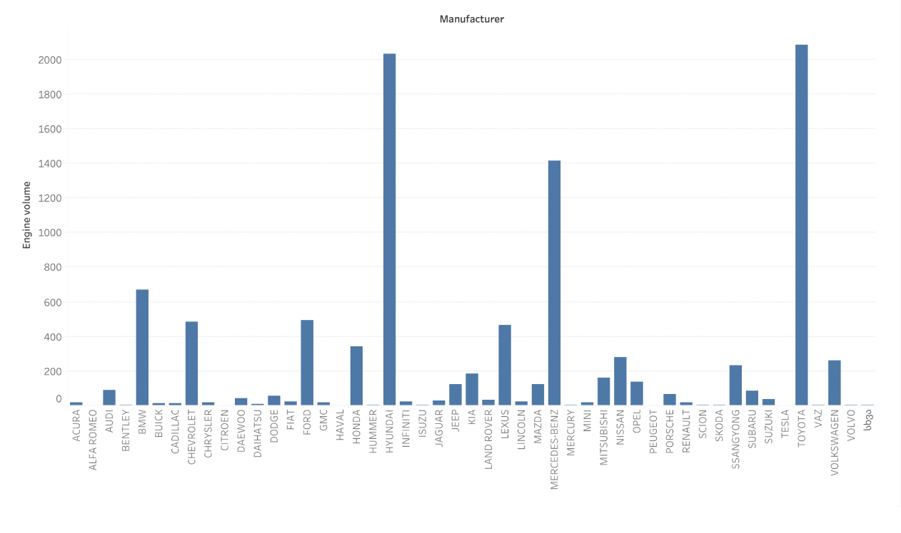
Data Visualization

Slide 12
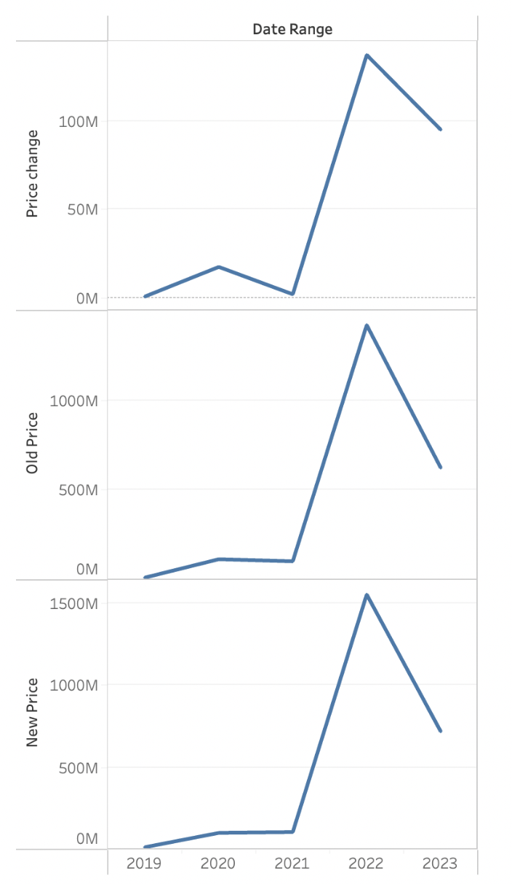
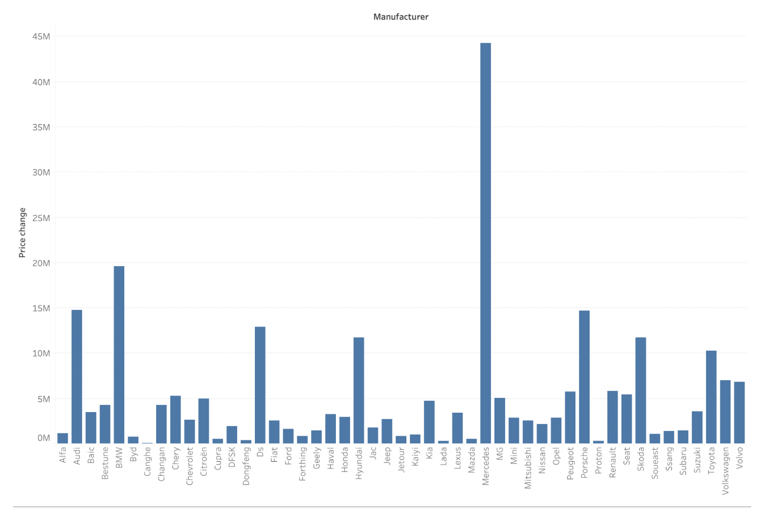
Data Visualization

Slide 13
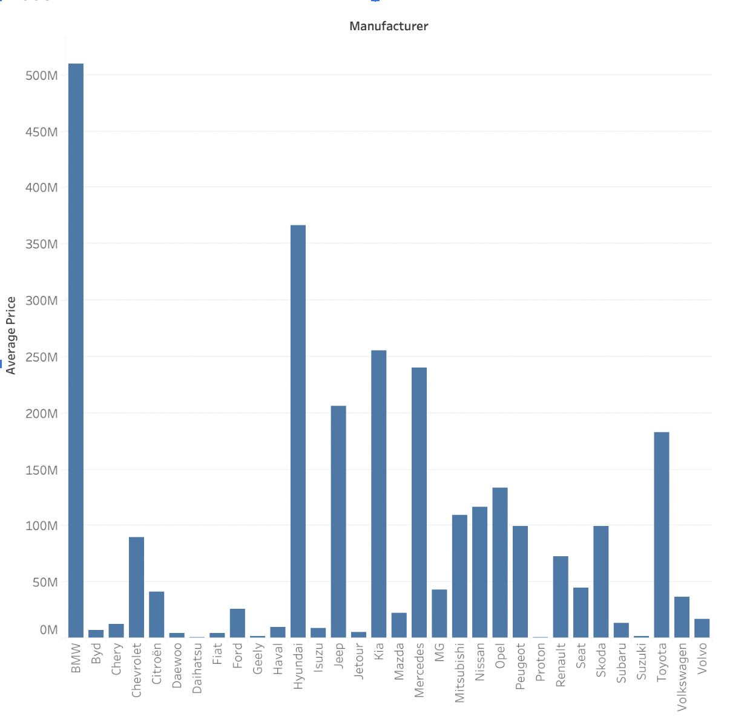
Data Visualization

Slide 14
Thank You

